Slide 1
Notes:
All of us have encountered a situation where code works on developer system but doesn’t work on testing environment. Docker at a very basic level resolves this issue of working on one platform and not working on another. However there is much more to docker. Docker is present in the entire project workflow but its main use is in deployment.

Slide 3
Notes:
Every time you deploy do you get scare?

Slide 4

Notes:
Do you want to have confidence with each deployment?

Slide 5
Why Docker is important for pipeline?
Notes:
While you can absolutely use Jenkins without Docker, using Docker provides two big advantages: ease of setup, and replicability. Both of these are due to how Docker uses images and containers.
Same container can run on a Mac, Linux, or modern Windows operating system without modification beyond certain command line options or file system considerations.
What this means for our purposes is that if we have a Docker image for Jenkins we can run a container for Jenkins on any machine that supports Docker with little modification and easily repeat the process across multiple machines.

Slide 6
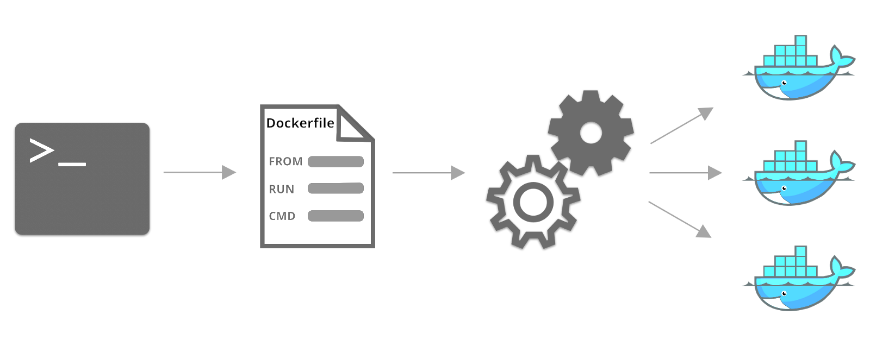
Notes:
Dockerfile – steps to create a docker image, it’s like a recipe with all ingredients and steps necessary in making your disk.
Docker file can be used to create docker image.

Slide 7
Docker image has application requirements and dependencies
Notes:
In the doocker image you’ll have application requirements and dependencies.
When you run docker image, you get docker container.
Docker images can also be stored in cloud repository, docker hub, you can also store docker images in your git repo.
These images can be pulled to create container in any environment.

Slide 8
Containers are running instance of docker image
Notes:
Containers allows us to package up an application with all of the parts it needs such as libraries and other dependancies, and docker ship it all out as one package.
With docker you test your application insider a container and ship it inside a container. This means the environment which you test is identical to the one which the app will run in production.

Slide 9
docker info
Notes:
To check if docker is installed properly, run this command
Explain information displayed.

Slide 10
docker pull jenkinsci/blueocean
Notes:
There are different types of Jenkins image available on docker hub.
You can go to docker hub and search for Jenkins images.
jenkinsci/blueocean image is the recommended one for pipelines. Blue Ocean is altogether a more generous attempt to address the user experience issue. Beauty with brains, I must say.
Jenkins Blue Ocean comes with an embedded tool called the Visual Pipeline Editor. This tool allows users to create and edit their pipeline visually using a UI interface that’s accessible directly from the pipeline dashboard. Also, the Visual Pipeline Editor saves your pipeline in code inside a file (Jenkinsfile), following the Declarative Pipeline Syntax, directly to your source code repository.
The pipeline visualization allows users to diagnose pipeline failures with ease and speed. When a pipeline fails, Blue Ocean tells you exactly where it has failed by pointing out the failed step. Also, the pipeline logs are displayed individually for every stage and step of a pipeline, so that users do not end up scrolling through a single huge log.
Blue Ocean also creates separate pages to view your testing results and built artifacts for every pipeline run.
The pipeline creation process in Jenkins Blue Ocean is more like a wizard. It also comes with a UI tool to create and edit pipelines. Above all, it has an interactive pipeline visualization, which makes your pipeline easy to understand.
We’ll explore this in few minutes. Now, lets start Jenkins in docker and create our first pipeline.

Slide 11
First Pipeline
Notes:
My first pipeline – we’ll create a pipeline with Jenkins pipeline configuration.
There are 2 types of pipelines – scripted and declarative pipeline.
Both are basically using same pipeline subsystem. Difference is in syntax and flexibility.
Declarative pipeline limits what is available to the user
Scripted pipeline has same limitations as groovy programming language and is preferred choice for complex projects.
Explain below docker commands -
docker run -u root --rm -d -p 8080:8080 -v jenkins-data:/var/jenkins_home -v /var/run/docker.sock:/var/run/docker.sock --name myjenkins jenkinsci/blueocean
docker run -d -v /var/run/docker.sock:/var/run/docker.sock -p 127.0.0.1:1234:1234 bobrik/socat TCP-LISTEN:1234,fork UNIX-CONNECT:/var/run/docker.sock
docker run --rm -e DOCKER_HOST=docker.for.mac.localhost:1234 docker info
docker exec myjenkins cat /var/jenkins_home/secrets/initialAdminPassword
Now configure the docker url –
Go to http://localhost:8080/configure
Set Docker url to tcp://docker.for.mac.localhost:1234

Slide 12
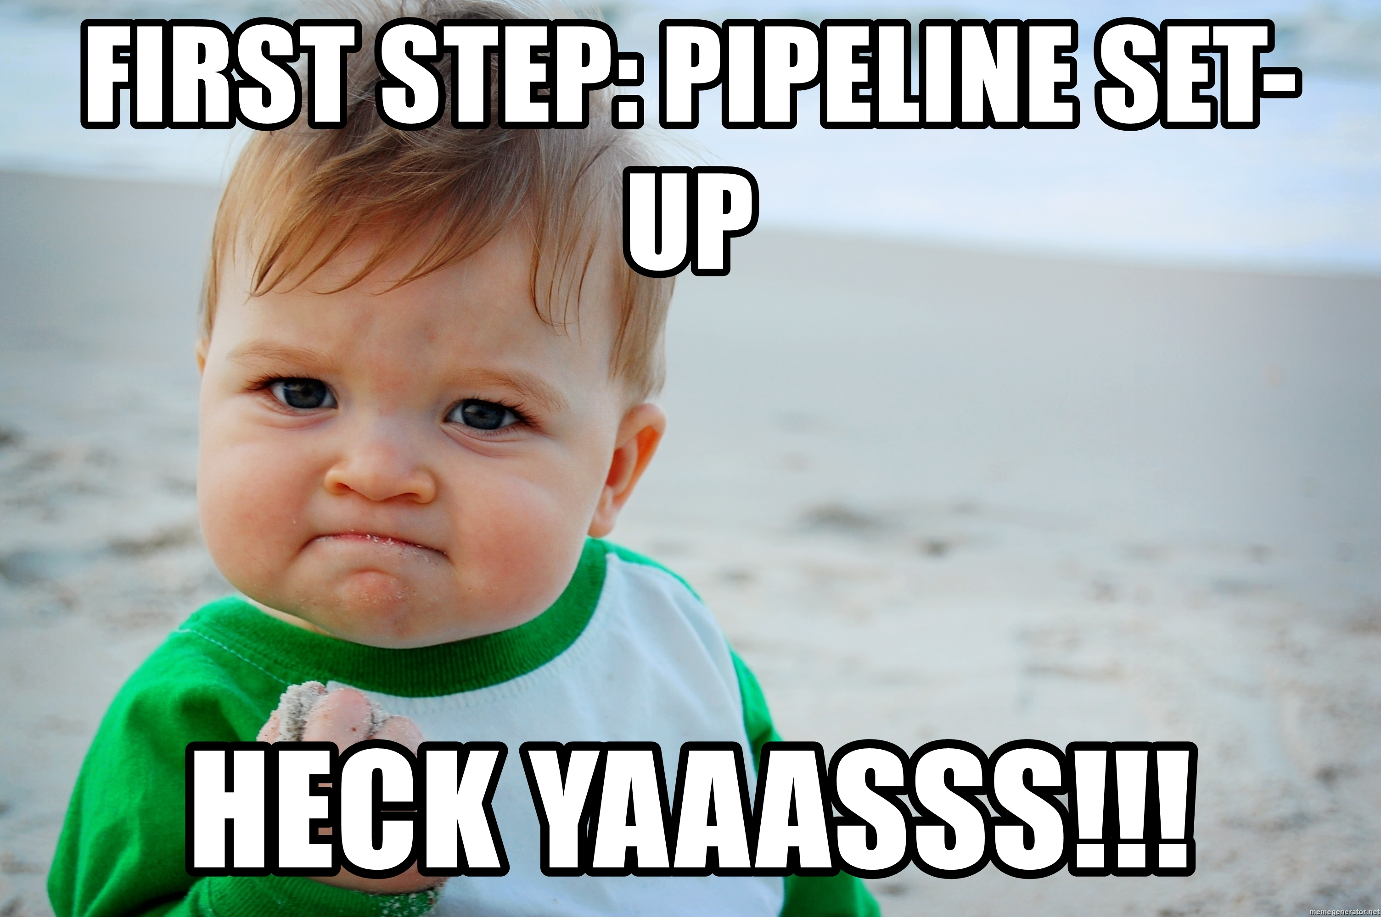

Slide 13
Declarative Pipeline Syntax
pipeline {
agent {
docker {
image 'myregistry.com/node’
label 'my-defined-label’
registryUrl 'https://myregistry.com/’ }
}
}
pipeline {
agent any
}
Notes:
All valid Declarative Pipelines must be enclosed within a pipeline block
Agent - The agent section specifies where the entire Pipeline, or a specific stage, will execute in the Jenkins environment depending on where the agent section is placed. These parameters can be applied at the top-level of the pipeline block, or within each stage directive.
Agent – any, node, label, docker, dockerfile
Stage - Containing a sequence of one or more stage directives, the stages section is where the bulk of the "work" described by a Pipeline will be located. At a minimum it is recommended that stages contain at least one stage directive for each discrete part of the continuous delivery process, such as Build, Test, and Deploy.
When - The when directive allows the Pipeline to determine whether the stage should be executed depending on the given condition. The whendirective must contain at least one condition. If the when directive contains more than one condition, all the child conditions must return true for the stage to execute.

Slide 14
pipeline {
agent any
stages {
stage('Example') {
steps {
echo 'Hello World’
}
}
}
}
Notes:
Stage - Containing a sequence of one or more stage directives, the stages section is where the bulk of the "work" described by a Pipeline will be located. At a minimum it is recommended that stages contain at least one stage directive for each discrete part of the continuous delivery process, such as Build, Test, and Deploy.

Slide 15
stages {
stage('Parallel Stage’) {
parallel {
stage('Branch A') {
steps {
echo "On Branch A"
}
}
stage('Branch B') {
steps {
echo "On Branch B"
}
}
}
}
Notes:
Stage - Containing a sequence of one or more stage directives, the stages section is where the bulk of the "work" described by a Pipeline will be located. At a minimum it is recommended that stages contain at least one stage directive for each discrete part of the continuous delivery process, such as Build, Test, and Deploy.

Slide 16
stage(Deploy') {
when {
branch 'production’
}
steps {
echo 'Deploying’
}
}
Notes:
When - The when directive allows the Pipeline to determine whether the stage should be executed depending on the given condition. The when directive must contain at least one condition. If the when directive contains more than one condition, all the child conditions must return true for the stage to execute.
Evaluating when before entering agent in a stage
By default, the when condition for a stage will be evaluated after entering the agent for that stage, if one is defined. However, this can be changed by specifying the beforeAgent option within the when block. If beforeAgent is set to true, the when condition will be evaluated first, and the agent will only be entered if the when condition evaluates to true.
Evaluating when before the input directive
By default, the when condition for a stage will be evaluated before the input, if one is defined. However, this can be changed by specifying the beforeInput option within the when block. If beforeInput is set to true, the when condition will be evaluated first, and the input will only be entered if the when condition evaluates to true.

Slide 17
Input / Pause
stages {
stage('Example') {
input {
message "Should we continue?"
ok "Yes, we should."
submitter ”john,smith"
parameters {
string(name: 'PERSON', defaultValue: 'Mr Jenkins’,
description: 'Who should I say hello to?’)
}
}
steps {
echo "Hello, ${PERSON}, nice to meet you." }
} }
Notes:
The input directive on a stage allows you to prompt for input, using the input step. The stage will pause after any options have been applied, and before entering the stage`s `agent or evaluating its when condition. If the input is approved, the stage will then continue. Any parameters provided as part of the input submission will be available in the environment for the rest of the stage.

Slide 18
Parameter
parameters {
password(name: 'PASSWORD', defaultValue: 'SECRET’, description: 'Enter a password’)
}
stages {
stage('Example') {
steps {
echo "Password: ${params.PASSWORD}”
}
}
}
Notes:
The input directive on a stage allows you to prompt for input, using the input step. The stage will pause after any options have been applied, and before entering the stage`s `agent or evaluating its when condition. If the input is approved, the stage will then continue. Any parameters provided as part of the input submission will be available in the environment for the rest of the stage.

Slide 19
Notes:
Let’s build basic pipeline with 3 stages – dev, integration and stage
Echo out some statement

